Slide 1


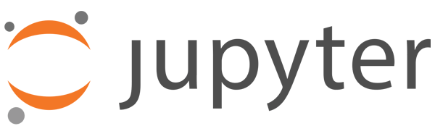
Spring 2021
TEP4290 Modeling of Built Environment Systems
Introduction to Python and Jupyter
Fernando Aguilar Lopez

Slide 2
How will we learn Python?
Flipped-classroom: You prepare some material in advance and we discuss it in class
PY4E: University of Michigan online course
Series of 3 “warm-ups” with pass/fail grading
Tutorials and discussions on warm-ups and project
Trial & error: Stack overflow may become your new best friend

Slide 3
Why using Python?
Free and open source
Large community, with many already available packages for all sorts of needs, also MFA!
No need to reinvent the wheel
General purpose language: you can use it successfully for other things than inverting matrices
Easy to connect to other platforms (data visualisation, etc.)
Extensively used for data science
Becoming more on more popular in both academia and the private sector.
More likely to impress on your resume than Matlab!
Elegant, compact and human readable code
Uses 0-based indexing (the first element of vector x is x[0], not x[1])

Slide 4
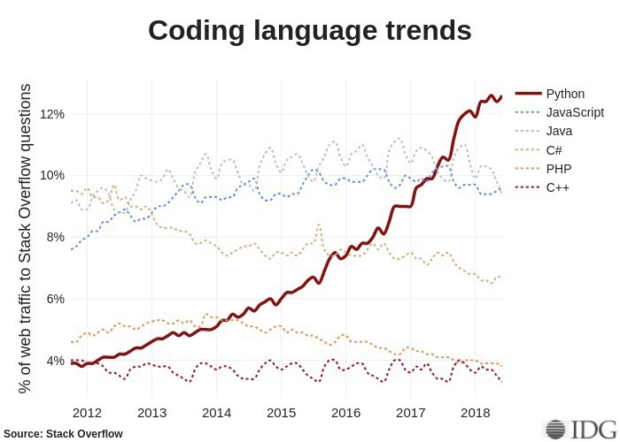
Why using Python?

Slide 5
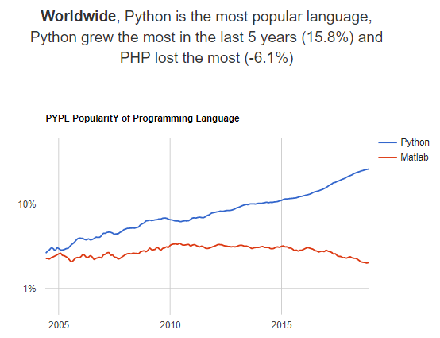
Why using Python?

Slide 6
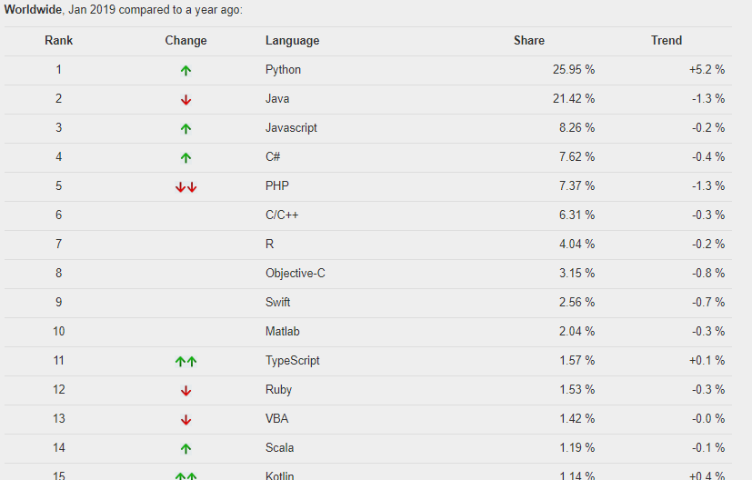
Why using Python?

Slide 7
Jupyter notebooks
Free and open source
Notebooks are a new tool to share information, mixing text, code, images etc.
Easy to use and (quite) intuitive
Very powerful to present work where you have to use code extensively
Very easy to share code with other people, without thinking about portability and compatibility issues
In our course: a JupyterHub server allows to store and execute all your code online, on a server hosted by NTNU.
No need to install anything
No issues if you use Mac / Windows / Linux / your phone / whatever
No version or configuration issues, everyon gets the same installation
To access the server, go to:
https://tep4290.apps.stack.it.ntnu.no

Slide 8




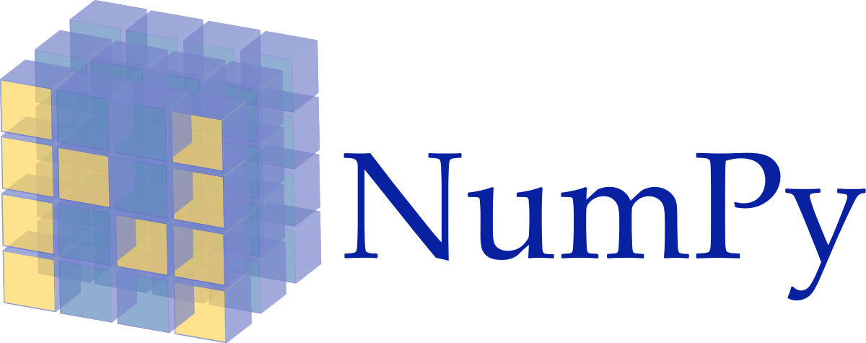

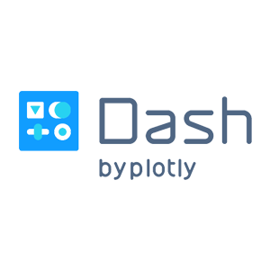
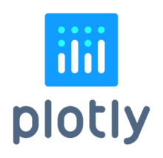





Useful Python packages and tools for MFA
Standard packages (most of these packages are already included in an Anaconda installation for example, or are available through pip):
Spyder (included with Anaconda) or PyCharm (alternative editor)
Pandas (data manipulation and management)
Numpy (matrix algebra)
Scipy (statistics, mathematical functions, curve fitting…)
Matplotlib or Plotly (plots and visualisation)
Bokeh or Dash (interactive data visulisation)
GeoPandas (GIS)
Requests (HTTP library), BeautifulSoup (HTML parsing) and Scrapy (web crawling for data collection)

Slide 9

Useful Python packages and tools for MFA
MFA specific packages
dynamic_stock_model: for simple MFA models. Easy to use, enables several lifetime probability functions, but quite slow and does not include types.
ODYM (Open Dynamic Material Systems Model): Provides a framework to design MFA systems in Python, with mass balance checks, different layers, different years etc. Includes a new version of the dynamic_stock_model, with better code and possibility to deal with initial stock, and a way to deal with negative inflows. Still no implementation of types in the stock
PYMFA: made at EMPA for probabilistic dynamic MFA More like a STAN for dynamic MFA. Enables MC simulation, data reconciliation and statistical entropy analysis over several years, but unable to compute stock-driven models.
Bayesian_MFA: Other tool for dynamic MC analyses, using Markov chains
MaTrace_Global: Model to trace the fate of materials in open-loop recycling . Based on Markov chains and IO.
https://github.com/IndEcol/Dashboard

Slide 10
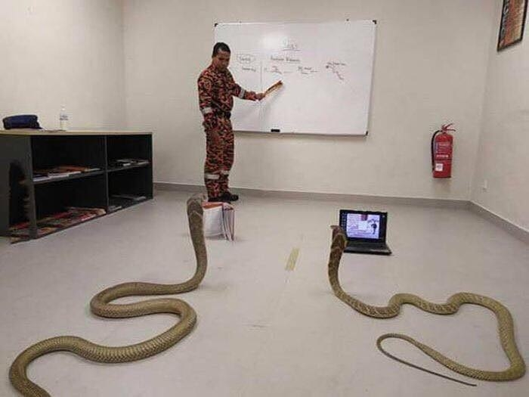
You think it’s hard?
Imagine pythons learning Human…

